Slide 1


Slide 2


Sagar Vasaikar
Saachi Shah
Tarang Haria
Airbnb User Booking Analysis

Slide 3
1 - Airbnb is a vacation rental marketplace with more than 2,000,000 vacation rentals in 190 countries listed on its website
2 - It operates through 50 websites in 23 languages through which it offers rentals of cabins, condos, castles, villas, barns, and farmhouses.
3 - Members can use the service to arrange or offer lodging, primarily homestays, or tourism experiences.
4 - So in this project we will be predicting the next destination of users, by this Airbnb can suggest more personalized content with their community, decrease the average time to first booking and better forecast demand.
Problem Statement

Slide 4
In this dataset, we are using different CSV files.
All the users in this dataset are from the USA.
The training & test sets are split by dates.
In the test set, we will predict all the new users with first activities after 7/1/2014
File descriptions
train_users.csv - the training set of users (213k rows:16 columns)
test_users.csv - the test set of users(62.1k rows:15 columns)
sessions.csv - web sessions log for users(10.6m rows:6 columns)
countries.csv - summary statistics of destination countries in this dataset & their locations(10 rows:7 columns)
age_gender_bkts.csv - summary statistics of users age group, gender, country of destination(420 rows:5 columns)
Dataset

Slide 5
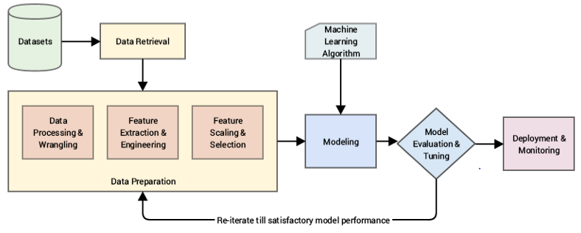
Procedure

Slide 6
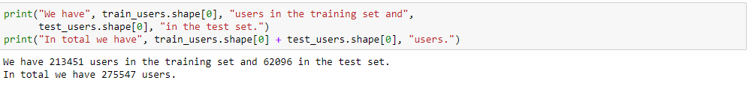
Data Description

Slide 7
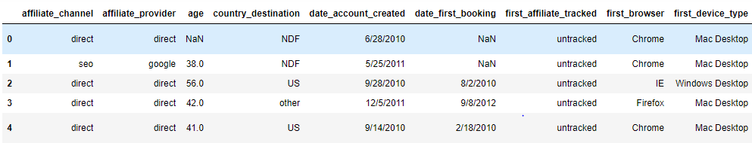
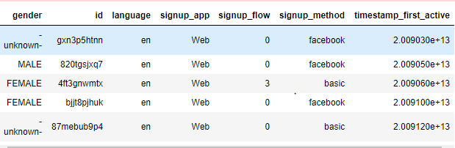
Data Description

Slide 8
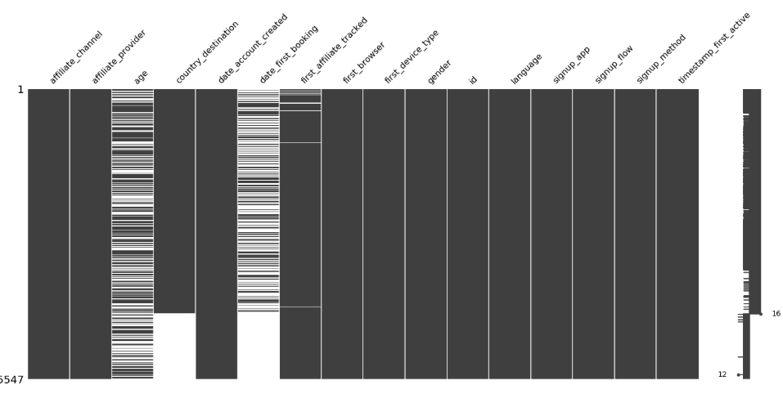
Data Cleaning

Slide 9
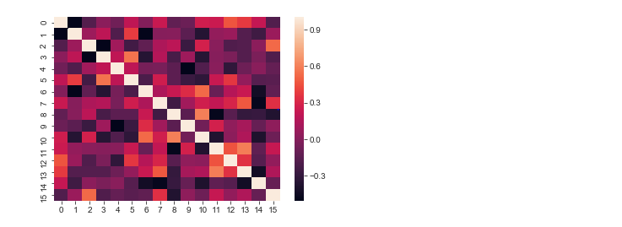
Exploratory Data Analysis
From this graph we observed that age is highly correlated with other attributes

Slide 10
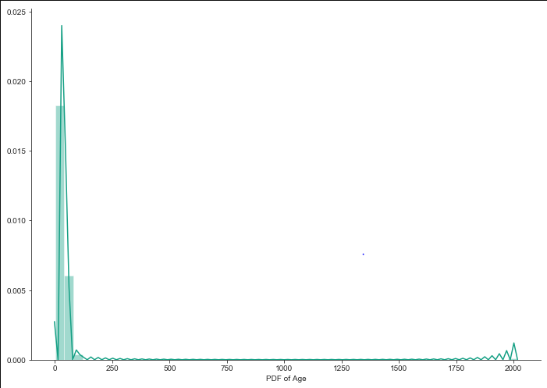
Exploratory Data Analysis
Age of the user lies in the range from 0 to 2000 which is not possible and not acceptable.
So to make the age column realistic we are removing the outliers and cutting the age range between 15-90.

Slide 11
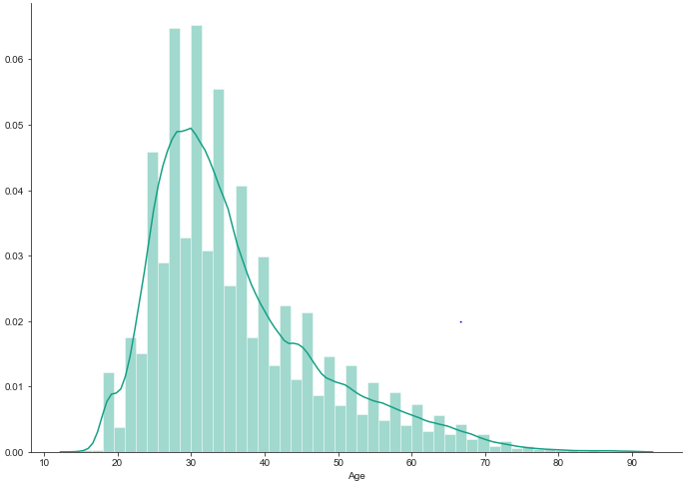
Exploratory Data Analysis
From the graph we can see that we have removed the outliers and now the age lies between 15-90.

Slide 12
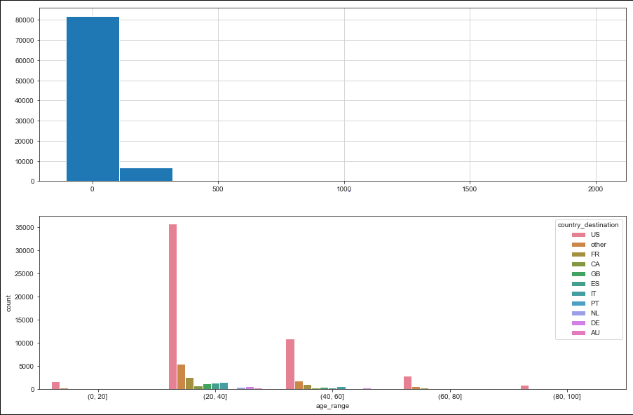
Exploratory Data Analysis
From the graph we can see that people with age range between 20 -40 have done maximum booking

Slide 13
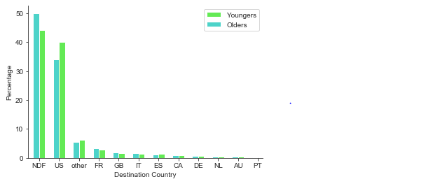
Exploratory Data Analysis
Young people tends to stay in the US, and the older people choose to travel outside the country.

Slide 14
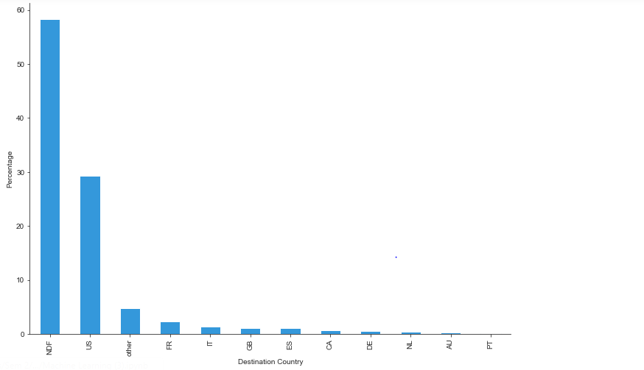
Exploratory Data Analysis
From this graph we can make out that most popular destination is USA.

Slide 15
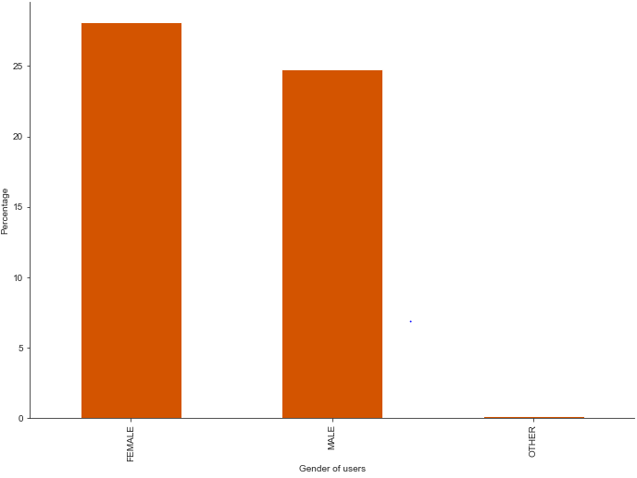
Exploratory Data Analysis
We can see there is no major difference between the booking percentage of the two genders.

Slide 16
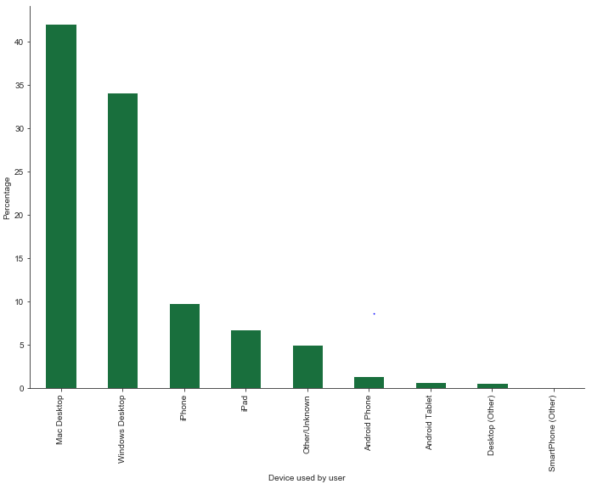
Exploratory Data Analysis
Most popular device that users use to first access Airbnb’s website is Mac desktop (40%) followed by Windows desktop (35%).

Slide 17
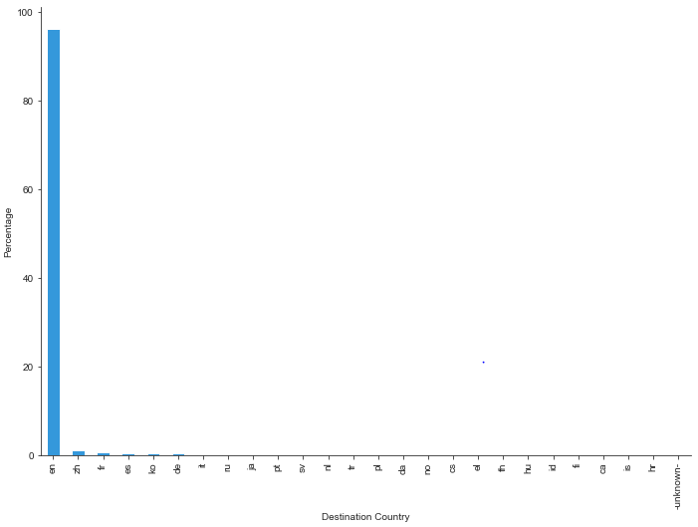
Exploratory Data Analysis
With the 96% of users using English as their language, it is understandable that a lot of people stay in the US.

Slide 18
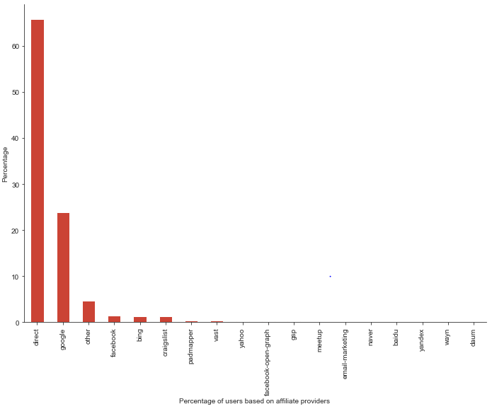
Exploratory Data Analysis
We see that nearly 70% of the users came to the Airbnb’s website directly without any affiliate involvement

Slide 19
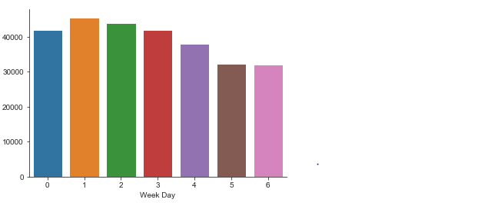
Exploratory Data Analysis
We can also see that Monday has the maximum number of booking.

Slide 20
Modeling
Logistic Regression
Decision Tree
Random Forest
K-Nearest Neighbor
Naïve Bayes Classifier
We will use the following modeling techniques for prediction.
The process includes feature selection & representation ,model selection and reasoning and description.

Slide 21
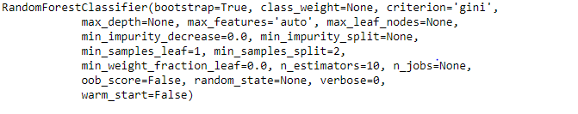

Random Forest Classifier

Slide 22
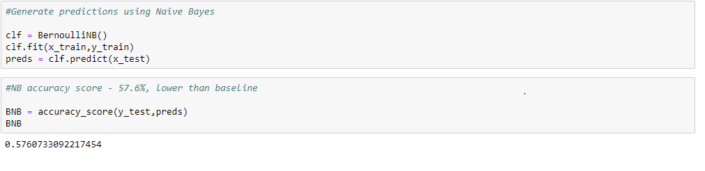
Bernoulli Naïve Bayes

Slide 23
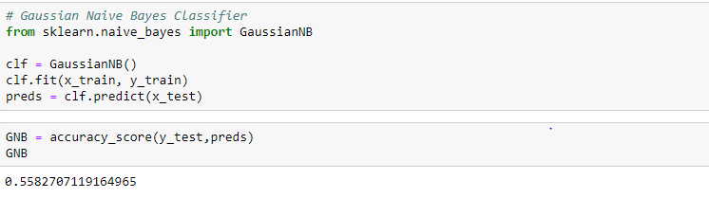
Gaussian Naïve Bayes

Slide 24
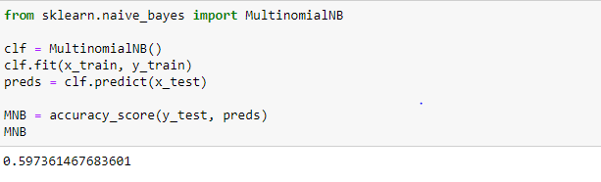
Multinomial Naïve Bayes

Slide 25
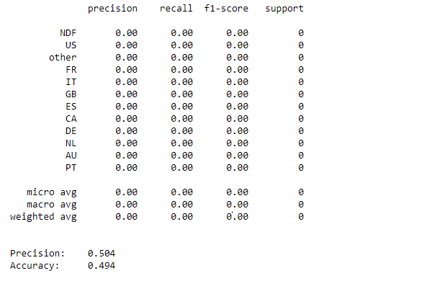
KNN Classifier

Slide 26
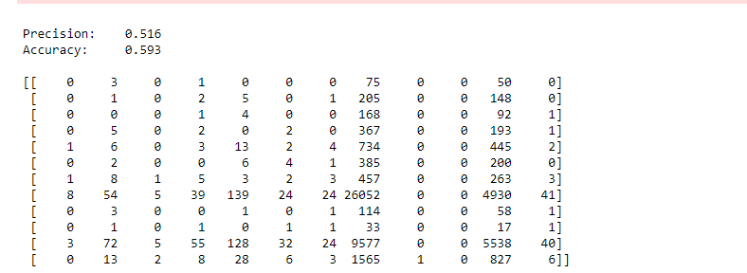
KNN Classifier

Slide 27
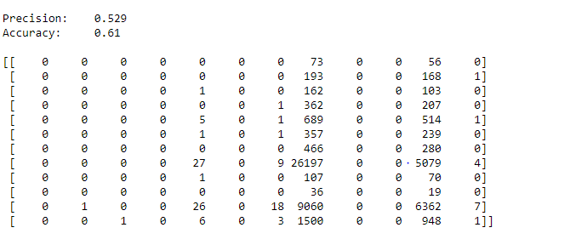
KNN Classifier

Slide 28
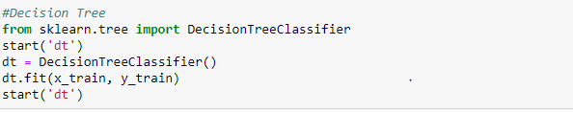
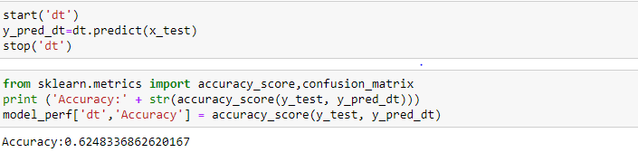
Decision Tree Classifier

Slide 29
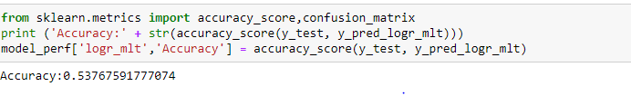
Logistic Regression

Slide 30
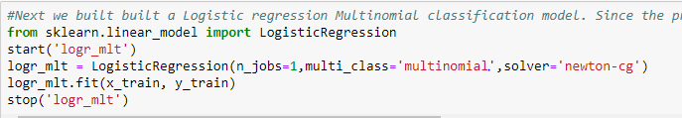
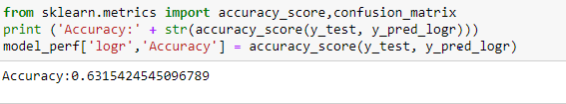
Multinomial Logistic Regression

Slide 31
Conclusion
Models | Accuracy
Random Forest Classifier | 62%
Bernoulli Naïve Bayes | 57%
Gaussian Naïve Bayes | 55%
Multinomial Naïve Bayes | 59%
KNN Classifier | 59%
Decision Tree Classifier | 62%
Logistic Regression | 53%
Multinomial Logistic Regression | 63%

Slide 32
Conclusion
Predicted next user destination – US
Network Trails -:
Affiliate Providers – Direct Website & google
Device Used – Mac OS and Windows
Target Marketing :-
Gender - Not much difference identified
Age Group – 20 – 40
Language – English

